Slide 1
LEVERAGING AI/ML FOR PLASTIC MARINE DEBRIS
Team - Marine Saviours!
India - Aeparish Mandhan (10 Yr) – Project and Team Selection, Data search & Understanding, Sunil Mandhan (Data Analysis), Kavya Padala (ML Models), Sriya (ML Models)
Malaysia – Naim Iskandar (Data Analysis)

Slide 2
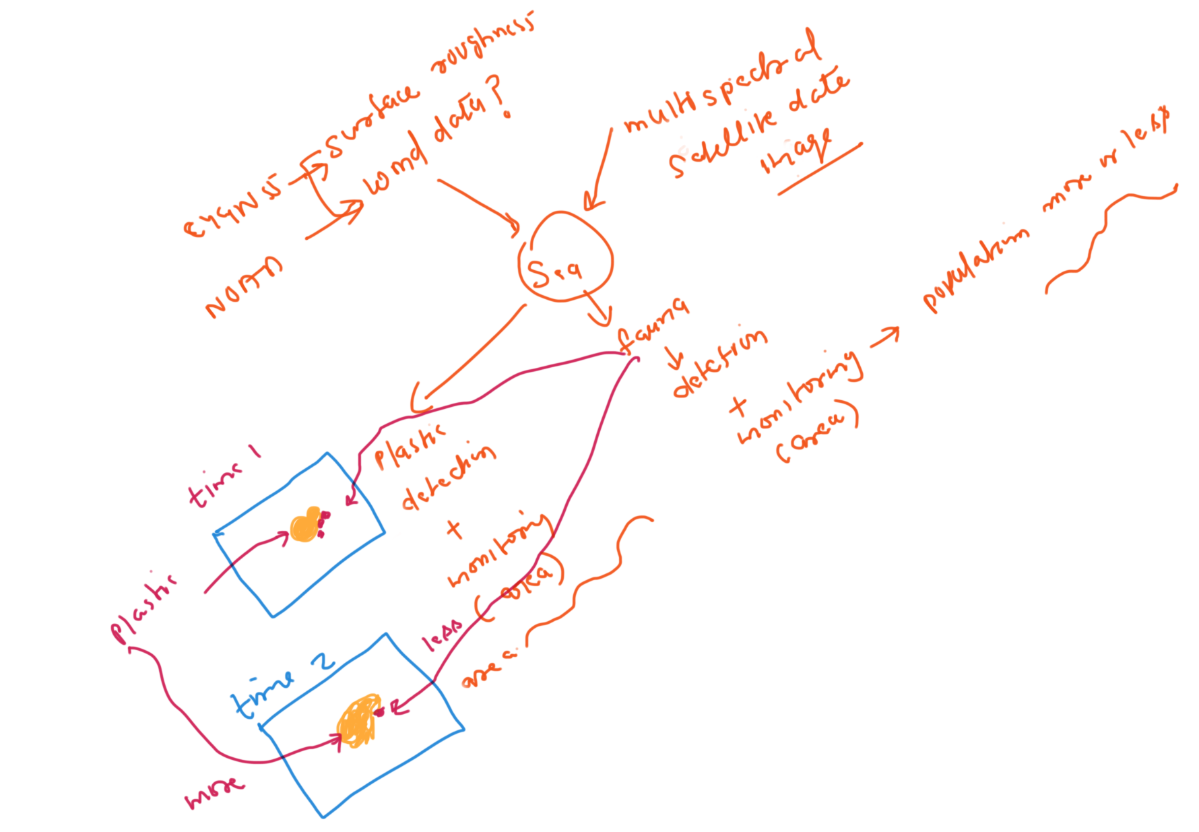
Approach
Approach was to take data from multiple sources (Like Sentinel 2, CYGNSS, NOAA) and fuse them together to make better prediction and detection.
Detect plastic debris using ML models (pixel based – Naïve Bayes, area segmentation based using Mask R CNN)
Detect Fauna (using both the model combination)
Track plastic debris area by using ML over a period
Track fauna area over a period
Showing the result to a web-based dashboard
Population trends on the bar chart
Plastic growth trends on bar chart
Detected plastic visualization on world map for each time period (each month or tunable time)

Slide 3
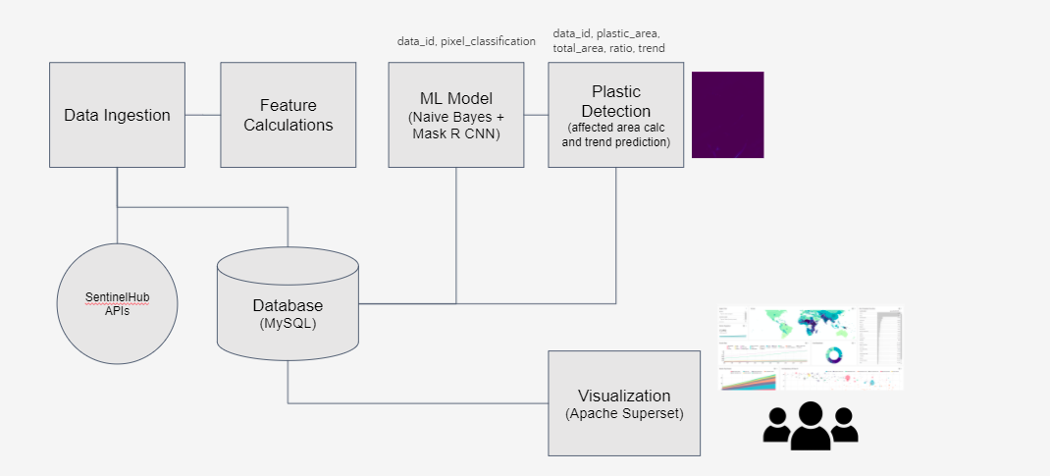
High Level Block Diagram

Slide 4
Challenges
Plastic Marine Debris is a problematic issue for both human and fauna in the water body as it hinders the free access to the clean water.
We started with the scope to detect plastic first visually and then develop ML model in parallel to detect it automatically.
In the beginning, we were not sure about the data and most focus was on the data selection and analysis.
We came across many sources with prominent ones Sentinel 2, CYGNSS, and NOAA but we found Sentinel 2 can solve the problem of plastic location as it used reflectance measurement in different spectral bands with visible and infrared and short infra red, it can see what eyes can’t see.
CYGNSS data had to be combined with NOAA data to make this judgement of plastic location hence it was discarded for this project.
Data Analysis took most of the chunk of the time for the hackathon as we needed to explore the data understanding and data reading in python programmatically.
We worked on ML models in parallel for both Naïve Bayes and MASK R CNN but integration became cumbersome due to data automation issues and absence of ground truth.

Slide 5
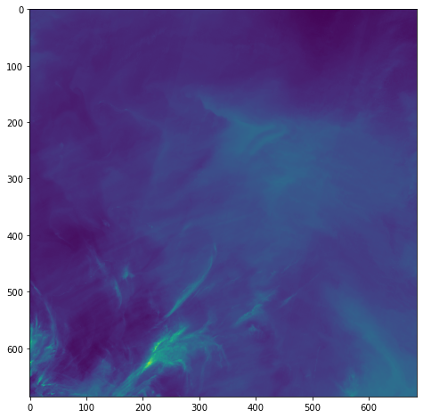
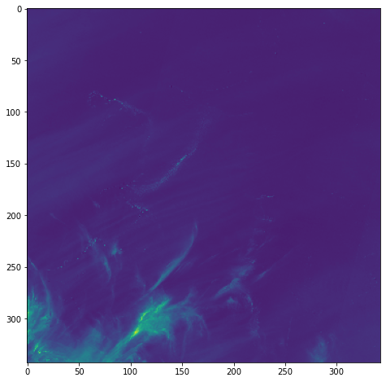
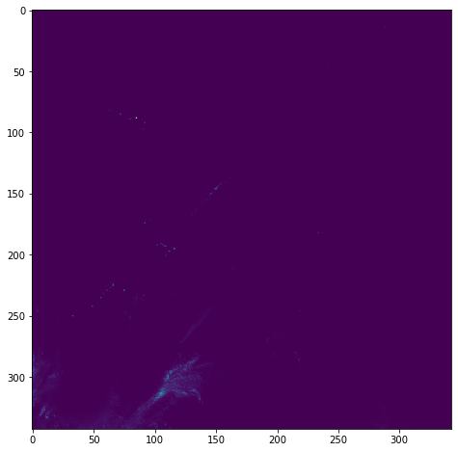
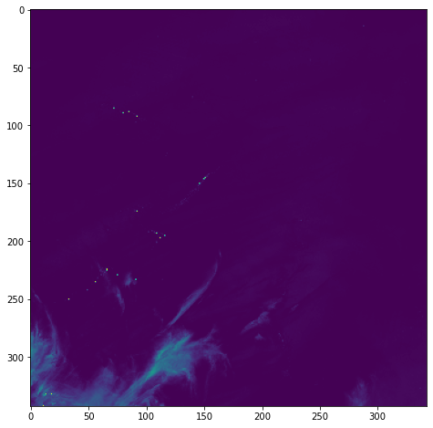




Results
We can see that FDI and NDVI features focus on the probable plastic debris
3
4
NDVI Feature – Visible Debris
1
Visible Band – No visible debris
2
NIR Band – Visible Debris (not clear)
FDI Feature – Visible Debris

Slide 6
Tools Used
Dataset used: Sentinel 2 L1C - https://sentinel.esa.int/web/sentinel/missions/sentinel-2
Hardware used: Google Colab Notebooks (https://colab.research.google.com/)
Software used: Python (Jupyter, EO Learn, rasterio, geopandas)
Sentinelhub APIs - https://www.sentinel-hub.com/
Sentinel Hub web browser - https://scihub.copernicus.eu/dhus/#/home
Apache Superset - https://superset.apache.org/
References
https://www.nature.com/articles/s41598-020-62298-z
https://www.mdpi.com/2072-4292/13/17/3401/htm

Slide 7
Conclusion and Future Plan
Conclusion
We have seen that AI/ML is very helpful in these kind of problems where data is huge and fast arriving and automatic classification can help detection of the marine debris and tracking them over a period which is humanly impossible.
All the source code and artefacts are available at the following link.
https://github.com/SGSunil/NasaSpaceChallengeMarineDebris
Details about the data (location, time) are given in the notebook under Data Analysis in the above link.
Future Plans
Integrating the ML Models with the data flow
Integrating the visualization tool in the data flow.
Demonstration of results improvement as the plan involves using the deep learning that looks promising.

Slide 8
Thank You
Team enjoyed 2 days working on the new domain of remote sensing and AI/ML applications.

